Slide 1
📊
Microsoft
Excel
Complete Teaching Deck - All Topics with Practical Examples
From Basics to Advanced | Formulas | Charts | PivotTables | Shortcuts
Interface
Formulas
IF and Logic
Lookup Functions
Text Functions
Date Functions
Charts
PivotTables
Conditional Format
Data Validation
Excel Tables
Shortcuts
Data Tools
Named Ranges
Power Query
Best Practices
KAJOLA GBENGA ADEWALE
Data Analytics Expert
Notes:
Title slide. This deck covers Microsoft Excel from the basics of navigation through to advanced techniques including Power Query, PivotTables, XLOOKUP, conditional formatting, and data validation. All examples use Nigerian business context.

Slide 2
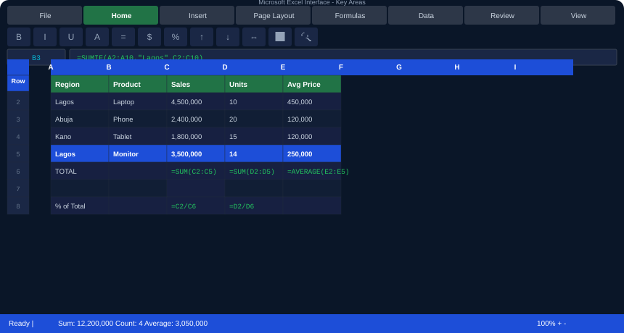
01. THE EXCEL INTERFACE - Know Your Way Around
Notes:
Excel interface. Key areas: (1) Title Bar - shows workbook name. (2) Ribbon - 8 tabs, each with groups of commands. (3) Name Box - shows cell address (B3). (4) Formula Bar - shows the formula or value in the active cell. (5) Column Headers - A through XFD (16,384 columns). (6) Row Numbers - 1 through 1,048,576 rows. (7) Sheet Tabs - navigate between sheets. (8) Status Bar - shows Sum, Count, Average of selected cells.

Slide 3
02. NAVIGATING EXCEL - Cells, Rows, Columns, Sheets
Cell References
Workbook vs Worksheet
Every cell has an address: Column letter + Row number. B3 = Column B, Row 3. Excel has 1,048,576 rows and 16,384 columns.
A Workbook is the .xlsx file. Each workbook contains Worksheets (tabs at the bottom). Right-click a tab to rename, add, delete, or move.
Select Multiple Cells
Freeze Panes
Click and drag to select a range. Ctrl+Click for non-adjacent cells. Shift+Click for a block. Ctrl+A to select all data.
View tab -&gt; Freeze Panes. Freezes rows/columns so they stay visible when scrolling. Essential for large datasets.
Go To (Ctrl+G)
Name Box
Jumps to any cell, range, or named range instantly. Use Special to find blanks, formulas, or constants.
Type any cell address (e.g. D500) and press Enter to jump there. Or type a range name to navigate to named ranges.
Notes:
Navigation fundamentals. The most important shortcut to teach first: Ctrl+End (jump to last used cell) and Ctrl+Home (jump back to A1). These two shortcuts alone save enormous time when working with large spreadsheets. Also emphasise freeze panes for data with many rows.

Slide 4
03
Data Entry and Formatting
Getting data in and making it look professional.

Slide 5
03. DATA ENTRY, TYPES, AND BASIC FORMATTING
data_entry.xlsx
Topic
Explanation
-- Data Types in Excel --
Numbers: 45000 3.14 -200 1.5E6
Text: Lagos Product A 'Enter as Text
Dates: 15/01/2024 Jan 15 2024 01-15-24
Logical: TRUE FALSE
Errors: #DIV/0! #N/A #REF! #VALUE!
-- Number Formats (Ctrl+1 -&gt; Format Cells) --
General: 45000
Number: 45,000.00
Currency: NGN 45,000.00
Percentage: 24.5%
Date: 15 January 2024
Custom: NGN #,##0 0.00% DD/MM/YYYY
-- Useful Entry Shortcuts --
Ctrl+; Insert today's date: 25/06/2026
Ctrl+Shift+: Insert current time: 09:30
Alt+Enter New line within a cell
Ctrl+D Fill formula/value DOWN
Ctrl+R Fill formula/value RIGHT
F4 Repeat last action
Numbers
Excel stores numbers as numeric values. Never type commas yourself (45,000) - use number format. Excel right-aligns numbers.
Text
Excel left-aligns text. To force a number to be stored as text, type an apostrophe first: '001234. Used for IDs and codes.
Dates
Internally stored as numbers (days since 01/01/1900). This enables date arithmetic: =B2-A2 gives days between two dates.
#DIV/0! error
Occurs when dividing by zero. Wrap with: =IFERROR(A1/B1, 0) to show 0 instead.
#N/A error
Lookup function could not find the value. Wrap with IFERROR or use XLOOKUP's [if_not_found] parameter.
#REF! error
A referenced cell was deleted. The formula lost its reference. Update the formula to point to valid cells.
errors.xlsx
#VALUE! error
Wrong data type in formula. Usually means text in a cell where a number is expected.
-- Error Handling --
=IFERROR(A1/B1, 0) &lt;- show 0 if error
=IFERROR(A1/B1, "-") &lt;- show dash if error
=IF(B1=0, "N/A", A1/B1) &lt;- check before divide
=IFNA(VLOOKUP(...),'Not found') &lt;- for #N/A
Custom format NGN #,##0
Creates a Nigerian Naira currency display: NGN 45,000. Does not change the underlying value.
Notes:
Data entry. The critical teaching point: Excel is right-aligns numbers and left-aligns text automatically. If a number is left-aligned, it is stored as text and CANNOT be used in calculations. This is the most common data entry problem. Fix with: select cells -> Data -> Text to Columns -> Finish.

Slide 6
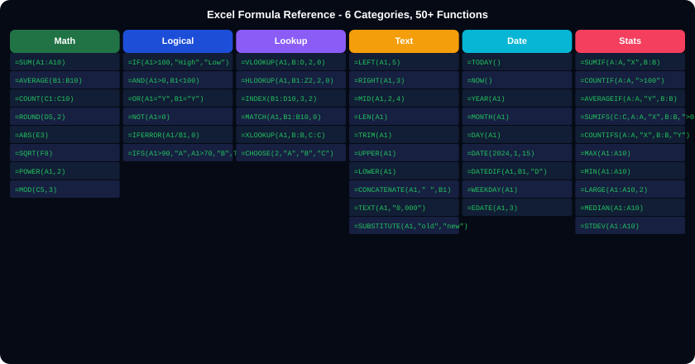
04. FORMULAS - The Engine of Excel
Notes:
Formula overview. All formulas start with = (equals sign). Arguments are separated by commas. Range references use colon: A1:A10 means A1 through A10. Key principle: formulas are RELATIVE by default - they adjust when copied. Use $ to make references ABSOLUTE: $A$1 never changes. $A1 fixes column only. A$1 fixes row only.

Slide 7
04A. CELL REFERENCES - Relative, Absolute, and Mixed
references.xlsx
Reference Type
Explanation and When to Use
-- Relative Reference (default) --
=A1+B1 When copied to next row: =A2+B2
=SUM(B2:B10) Adjusts row numbers when copied
Use when: copying same formula across rows/cols
-- Absolute Reference (use $ sign) --
=$A$1+B1 $A$1 NEVER changes when copied
=B2*$D$1 D1 stays fixed (e.g. tax rate cell)
Shortcut: Press F4 to toggle $ on a reference
-- Mixed References --
=$A1 Column A fixed, row changes
=A$1 Row 1 fixed, column changes
Use when: building multiplication tables
-- Real Example (Tax Calculator) --
Tax Rate is in D1 = 0.075 (7.5%)
B2: Sales = 500,000
C2: Tax = =B2*$D$1 &lt;- D1 stays fixed
C3: Tax = =B3*$D$1 &lt;- copied down: B3*D1
If D1 changes, ALL tax calculations update
A1 (Relative)
Both column and row adjust when copied. Use in most standard formulas that repeat down a dataset.
$A$1 (Absolute)
Both column and row are FIXED. Use when referencing a single config cell (tax rate, target, exchange rate).
$A1 (Column fixed)
Column A is fixed but row changes. Use in a cross-reference table where rows change but the column is fixed.
A$1 (Row fixed)
Row 1 is fixed but column changes. Use in multiplication tables where you move right but the row stays.
F4 key
Cycles through A1 -&gt; $A$1 -&gt; A$1 -&gt; $A1 -&gt; A1. Press while the cursor is on a reference in the formula bar.
Best practice
Put all configurable values (rates, targets, dates) in a dedicated area and reference them absolutely. Change one cell to update the whole model.
f4.xlsx
-- F4 Shortcut Cycles --
A1 (press F4) -&gt; $A$1
$A$1 (press F4) -&gt; A$1
A$1 (press F4) -&gt; $A1
$A1 (press F4) -&gt; A1
=B2*$D$1 &lt;- classic absolute usage
Notes:
Cell references. This is the most important concept in Excel after understanding formulas. The $ sign is not a currency symbol - it LOCKS the reference. The best way to teach this: build a tax calculator table where D1 has the tax rate, and show how $D$1 keeps pointing to D1 regardless of where the formula is copied.

Slide 8
05. MATH AND STATISTICAL FUNCTIONS
math_fns.xlsx
Function
What It Does - Real Business Example
-- Basic Aggregation --
=SUM(B2:B100) Sum of all values
=AVERAGE(C2:C100) Mean of all values
=COUNT(D2:D100) Count of numbers
=COUNTA(A2:A100) Count of non-empty cells
=MAX(B2:B100) Highest value
=MIN(B2:B100) Lowest value
=MEDIAN(B2:B100) Middle value
=STDEV(B2:B100) Standard deviation
=LARGE(B2:B100, 2) 2nd largest value
=SMALL(B2:B100, 3) 3rd smallest value
-- Conditional Aggregation --
=SUMIF(A:A, "Lagos", B:B)
Sum B where A = 'Lagos'
=COUNTIF(A:A, "&gt;50000")
Count cells in A greater than 50,000
=AVERAGEIF(A:A, "Lagos", B:B)
Average of B where A = 'Lagos'
-- Multiple Conditions (SUMIFS) --
=SUMIFS(C:C, A:A, "Lagos", B:B, "Laptop")
Sum C where A=Lagos AND B=Laptop
=COUNTIFS(A:A,"Lagos",B:B,"&gt;50000")
Count rows where A=Lagos AND B&gt;50000
-- Rounding --
=ROUND(3.14159, 2) -&gt; 3.14
=ROUNDUP(3.1, 0) -&gt; 4
=ROUNDDOWN(3.9, 0) -&gt; 3
=INT(3.9) -&gt; 3 (drop decimal)
=MOD(17, 5) -&gt; 2 (remainder)
=SUM(B2:B100)
Adds all values in B2 through B100. Use for total revenue, total units, total expenses.
=SUMIF(A:A,"Lagos",B:B)
Sums column B only where column A equals 'Lagos'. Three arguments: Range to check, Criteria, Range to sum.
=SUMIFS(C:C,A:A,"X",B:B,"Y")
Like SUMIF but multiple conditions. Sum C where A='X' AND B='Y'. Note: arguments come in pairs after the sum range.
=COUNTIF(A:A,"&gt;50000")
Counts cells in column A that are greater than 50,000. For text: COUNTIF(A:A,"Lagos"). Wildcard: COUNTIF(A:A,"Lag*").
=LARGE(B2:B100, 2)
Returns the 2nd largest value. Change 2 to 3 for 3rd largest. Useful for Top N analysis.
=STDEV(B2:B100)
Standard deviation - measures how spread out values are. Low stdev = consistent. High stdev = variable.
=ROUND(A1, 2)
Rounds to 2 decimal places. Second argument is decimals: 0 = whole number, -1 = round to 10s, -2 = round to 100s.
Notes:
Math functions. The SUMIFS family (SUMIFS, COUNTIFS, AVERAGEIFS) is the most important group for business analysis. Key difference from SUMIF: SUMIFS puts the sum_range FIRST, then criteria pairs. Many students confuse this. Also: COUNTIFS has no sum_range - just criteria ranges.

Slide 9
06. IF, AND, OR - Logical Functions
logic_fns.xlsx
Function
What It Does
-- Basic IF --
=IF(condition, value_if_true, value_if_false)
=IF(B2&gt;50000, "High", "Low")
=IF(C3="Lagos", "Local", "Upcountry")
-- Nested IF (up to 64 levels) --
=IF(B2&gt;=90, "Excellent",
IF(B2&gt;=70, "Good",
IF(B2&gt;=50, "Average", "Poor")))
-- IFS (cleaner multiple conditions) --
=IFS(B2&gt;=90, "Excellent",
B2&gt;=70, "Good",
B2&gt;=50, "Average",
TRUE, "Poor")
Note: Last condition TRUE catches everything else
-- AND, OR with IF --
=IF(AND(B2&gt;50000, C2="Lagos"),
"Priority", "Standard")
Both must be TRUE for Priority
=IF(OR(D2="VIP", B2&gt;500000),
"Priority", "Standard")
Either one being TRUE gives Priority
-- IFERROR and IFNA --
=IFERROR(A1/B1, 0)
=IFERROR(VLOOKUP(A1,Table,2,0), "Not found")
=IFNA(VLOOKUP(...), "Missing")
IFNA only catches #N/A. IFERROR catches all.
=IF(cond, true, false)
Tests a condition. If TRUE returns first value. If FALSE returns second. Both text and number results are valid.
Nested IF
An IF inside another IF. Excel evaluates the outer IF first. If FALSE, it evaluates the nested IF. Limit nesting to 3-4 levels - use IFS beyond that.
=IFS(cond1,val1,cond2,val2)
Tests multiple conditions in order. Returns the value for the first TRUE condition. Always end with TRUE as a catch-all.
=AND(cond1, cond2)
Returns TRUE only if ALL conditions are TRUE. Inside IF: IF(AND(A&gt;0,B&gt;0),"Both positive","No").
=OR(cond1, cond2)
Returns TRUE if ANY condition is TRUE. Inside IF: IF(OR(A="VIP",B&gt;1M),"Priority","Standard").
=IFERROR(formula, val)
Evaluates formula. If any error occurs, returns val instead. Wrap ALL lookups and divisions with IFERROR.
=NOT(condition)
Reverses TRUE to FALSE and FALSE to TRUE. IF(NOT(A1=0),...) is same as IF(A1&lt;&gt;0,...).
Notes:
IF and logic. The most common mistake: forgetting the last TRUE catchall in IFS. Without it, IFS throws an error if none of the conditions match. Also teach: the text in IF results MUST be in quotes. IF(B2>50, High, Low) fails. IF(B2>50, "High", "Low") works.

Slide 10

07. LOOKUP FUNCTIONS - VLOOKUP, INDEX-MATCH, XLOOKUP
lookup.xlsx
VLOOKUP: =VLOOKUP(A2, ProductTable, 3, 0) | 3 = return column 3 | 0 = exact match
XLOOKUP: =XLOOKUP(A2, Products[Code], Products[Price], "Not found") | No column number needed!
Notes:
Lookup functions. VLOOKUP limitation: the lookup column MUST be the leftmost column in the table. You cannot look left. INDEX+MATCH solves this. XLOOKUP is the modern replacement for both. Key: always use 0 or FALSE as last argument for exact match. 1 or TRUE does approximate match (requires sorted data).

Slide 11
07A. VLOOKUP - Step by Step with Real Example
vlookup_eg.xlsx
Argument
What It Means
-- Scenario --
You have an Orders table and a Products table.
You need the Price from Products for each order.
Products Table (F1:H5):
F G H
Code Product Price
LAP001 Laptop 450000
PHN001 Phone 120000
TAB001 Tablet 180000
Orders Table:
A B C (formula here)
OrderID ProdCode Price
ORD-001 LAP001 =VLOOKUP(B2, $F$1:$H$5, 3, 0)
ORD-002 PHN001 =VLOOKUP(B3, $F$1:$H$5, 3, 0)
Result: C2 = 450,000 (Laptop price)
lookup_value (B2)
The value you are searching FOR. In our example: the product code from column B of the orders table.
table_array ($F$1:$H$5)
The table containing the data you want. Must include the lookup column as the FIRST column. Use $ to make it absolute.
col_index_num (3)
Which column of the table to return. 1=first column, 2=second, 3=third. We want Price which is the 3rd column.
range_lookup (0 or FALSE)
ALWAYS use 0 (exact match) in business use. 1 (approximate) only works with sorted data and is dangerous.
Why $F$1:$H$5 not F1:H5
When you copy the formula down to other rows, a relative reference would shift. $ locks the table location.
VLOOKUP limitation
The lookup column MUST be the leftmost column. Cannot look LEFT. Cannot return data from a column to the LEFT of the lookup column.
vlookup_err.xlsx
-- Common VLOOKUP Errors --
#N/A -&gt; value not in lookup table (check spelling)
#REF! -&gt; col_index_num too large for table
Wrong result -&gt; last arg is TRUE not 0/FALSE
Fix: =IFERROR(VLOOKUP(B2,$F$1:$H$5,3,0),"?")
Notes:
VLOOKUP detailed. The three most common errors: (1) Forgetting exact match - leaving last argument as TRUE or empty returns wrong results on unsorted data. (2) Relative reference on the table - when copied down, F1:H5 becomes F2:H6, missing data. Always lock with $. (3) Column number changes when columns are inserted - use INDEX-MATCH or XLOOKUP to avoid this.

Slide 12
08. TEXT FUNCTIONS - Clean, Split, Join Text
text_fns.xlsx
Function
What It Does - Business Use
-- Extract Text --
=LEFT("LAGOS-001", 5) -&gt; "LAGOS"
=RIGHT("LAGOS-001", 3) -&gt; "001"
=MID("LAGOS-001", 7, 3) -&gt; "001"
^start ^chars
-- Clean Text --
=TRIM(" Lagos ") -&gt; "Lagos"
=CLEAN(A1) Remove non-printable
=PROPER("lagos state") -&gt; "Lagos State"
=UPPER("lagos") -&gt; "LAGOS"
=LOWER("LAGOS") -&gt; "lagos"
-- Join Text (Concatenate) --
=A1and" "andB1 Ampersand join
=CONCAT(A1, " ", B1) Excel 2016+
=TEXTJOIN(", ",TRUE,A1:A5) Join with delimiter
delimiter--^ ^ignore blanks
-- Find and Replace --
=FIND("Lagos", A1) Position (case-sensitive)
=SEARCH("lagos", A1) Position (NOT case-sensitive)
=SUBSTITUTE(A1,"NGN","$") Replace all NGN with $
=REPLACE(A1, 1, 3, "XXX") Replace chars 1-3 with XXX
-- Number to Text --
=TEXT(45000, "NGN #,##0") -&gt; "NGN 45,000"
=TEXT(TODAY(), "DD MMM YYYY") -&gt; "25 Jun 2026"
=LEN(A1) Character count
=VALUE("45000") Text to number
=TRIM(A1)
Removes all leading, trailing, and extra internal spaces. Run on every text column imported from another system.
=LEFT(A1,5)
Returns first 5 characters. Use to extract product category codes, region prefixes from combined codes.
=MID(A1,7,3)
Returns 3 characters starting at position 7. Essential for extracting segments of structured codes like ORD-2024-001.
=SUBSTITUTE(A1,"old","new")
Replaces all occurrences of 'old' with 'new'. Use to clean currency symbols: SUBSTITUTE(A1,"NGN ","").
=TEXT(number,"format")
Converts a number to formatted text. =TEXT(45000,"NGN #,##0") returns 'NGN 45,000'. Different from number formatting - this creates TEXT.
=TEXTJOIN(", ",TRUE,A1:A5)
Joins all values in A1:A5 with a comma-space separator. TRUE means ignore blank cells. Perfect for creating comma-separated lists.
=VALUE("45000")
Converts text that looks like a number into an actual number. Use when imported data has numbers stored as text.
Notes:
Text functions. The TRIM+PROPER combination is the standard first-clean for any text column: =PROPER(TRIM(A1)). This removes spaces and standardises capitalisation in one step. TEXTJOIN is extremely powerful for creating summary strings. The & operator for concatenation is the most portable as it works in all Excel versions.

Slide 13
09. DATE AND TIME FUNCTIONS
date_fns.xlsx
Function
Business Use
-- Getting the Current Date/Time --
=TODAY() Today: 25/06/2026 (updates daily)
=NOW() 25/06/2026 09:30 (updates each calc)
-- Extracting Date Parts --
=YEAR(A1) Extract year: 2024
=MONTH(A1) Extract month: 6
=DAY(A1) Extract day: 25
=WEEKDAY(A1) Day of week: 2 (Mon=2)
=TEXT(A1,"MMMM") Month name: June
=TEXT(A1,"DDDD") Day name: Tuesday
-- Building Dates --
=DATE(2024, 12, 31) -&gt; 31/12/2024
=EDATE(A1, 3) -&gt; 3 months after A1
=EOMONTH(A1, 0) -&gt; Last day of A1's month
=EOMONTH(A1, 1) -&gt; Last day of next month
-- Date Arithmetic --
=B1 - A1 Days between two dates
=DATEDIF(A1,B1,"D") Days between (more control)
=DATEDIF(A1,B1,"M") Months between
=DATEDIF(A1,B1,"Y") Full years between
=NETWORKDAYS(A1,B1) Working days (excl weekends)
=A1+30 30 days after date in A1
=TODAY()
Used in formulas like =TODAY()-A1 to calculate age of an invoice. Volatile: recalculates every time Excel opens.
=DATEDIF(start,end,"D")
Best for date difference. 'D'=days, 'M'=months, 'Y'=years. Use 'YM' for months ignoring years (age calculation: years and months).
=EDATE(A1, 3)
Returns date exactly 3 months after A1. Handles month-end correctly: March 31 + 1 month = April 30, not April 31.
=EOMONTH(A1, 0)
Last day of the month in A1. Great for billing periods: EOMONTH(A1,-1)+1 = first day of A1's month.
=NETWORKDAYS(A1,B1)
Business days between two dates, excluding weekends. Add holidays range: NETWORKDAYS(A1,B1,Holidays).
=TEXT(A1,"MMMM YYYY")
Converts a date to text like 'January 2024'. Used in reports and chart labels where you want readable month names.
Date arithmetic tip
Excel stores dates as numbers so you can add/subtract days directly: =A1+7 gives one week after A1. =A1-TODAY() gives days until a deadline.
age.xlsx
-- Age Calculator --
=DATEDIF(B2, TODAY(), "Y")and" years, "andDATEDIF(B2,TODAY(),"YM")and" months"
Notes:
Date functions. DATEDIF is a hidden function - it does not appear in autocomplete but it works. The three unit arguments: D=days, M=complete months, Y=complete years. YM=months ignoring years, YD=days ignoring years. Perfect for 'you are 34 years, 8 months old' displays.

Slide 14
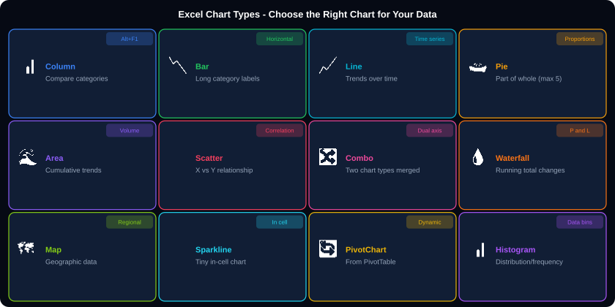
10. CHARTS AND VISUALISATION
How to create: Select data -> Insert tab -> Charts group -> Choose type. Right-click chart for Format, Change Type, Add Labels. Use Alt+F1 for instant column chart.
Notes:
Charts overview. The chart selection rule: if you are comparing categories use Column (vertical) or Bar (horizontal). If you are showing trend over time use Line. If you are showing proportion use Pie (max 5 categories). If you are showing two numeric variables use Scatter. If you are showing composition over time use Stacked Column.

Slide 15
10A. CREATING AND FORMATTING CHARTS
1
Select Your Data
2
Insert Chart
Select the cells including headers. Non-adjacent: hold Ctrl while selecting.
Insert tab -&gt; Charts group -&gt; Choose chart type. Or press Alt+F1 for instant column chart.
4
Add Chart Elements
3
Chart Design Tab
Click the + button on chart edge. Add: Title, Axis Titles, Data Labels, Legend, Gridlines, Trendline.
Appears when chart is selected. Change colours, apply styles, switch rows/columns.
charts.xlsx
5
Format Axis
6
Move and Resize
-- Sparklines: Tiny in-cell charts --
Select empty cells -&gt; Insert -&gt; Sparklines -&gt; Choose Line/Column/Win-Loss
Set Data Range: B2:M2 (12 months of data). Place sparkline in N2. Copy down for all rows.
-- Dynamic Chart with Table --
Convert data to Table (Ctrl+T) first. Chart auto-updates when rows added. No need to expand chart range manually.
Double-click an axis. Set min/max, number format, tick marks, labels.
Drag chart to move. Drag handles to resize. Right-click -&gt; Move Chart to put on separate sheet.
Notes:
Chart creation. The most professional tip: always convert data to an Excel Table before creating a chart. When the table grows (new rows added), the chart automatically includes the new data. Without this, you must manually expand the chart data range every time.

Slide 16
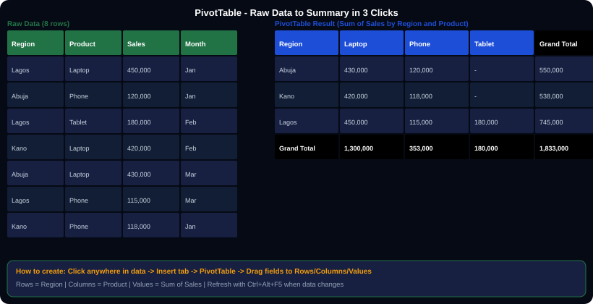
11. PIVOTTABLES - Summarise Thousands of Rows Instantly
PivotTable Field List areas: ROWS = categories down the left. COLUMNS = categories across the top. VALUES = numbers being calculated. FILTERS = dropdown filter at the top.
Notes:
PivotTables. The golden rule: your source data must be in tabular format (one header row, no blank rows, no merged cells, no totals row in the data). PivotTable is the single most powerful data analysis tool in Excel. A task that takes hours of formulas takes 30 seconds with a PivotTable.

Slide 17
11A. PIVOTTABLE - Grouping, Slicers, and Calculated Fields
pivot_detail.xlsx
Technique
How to Do It and Why
-- PivotTable Creation --
1. Click anywhere in your data
2. Insert -&gt; PivotTable -&gt; New Worksheet
3. Drag fields to areas:
ROWS: Region (categories down left)
COLUMNS: Product (categories across top)
VALUES: Sales -&gt; Sum of Sales
FILTERS: Year (optional dropdown filter)
-- Change Value Calculation --
Right-click a value -&gt; Value Field Settings
Options: Sum, Count, Average, Max, Min, %
Show Values As -&gt; % of Grand Total
Show Values As -&gt; % of Row Total
Show Values As -&gt; Running Total
-- Group Dates --
Right-click a date in ROWS -&gt; Group
Select: Years, Quarters, Months simultaneously
Creates automatic date hierarchy
-- Slicers --
PivotTable Analyze -&gt; Insert Slicer
Creates visual filter buttons
Can control MULTIPLE PivotTables at once!
(Slicer -&gt; Report Connections -&gt; select tables)
Refresh PivotTable
Ctrl+Alt+F5 refreshes all. Or right-click PivotTable -&gt; Refresh. MUST do this when source data changes. Does not auto-update.
Calculated Field
PivotTable Analyze -&gt; Fields Items Sets -&gt; Calculated Field. Add formulas using field names: =Sales / Units gives Avg Price.
Group by Month
Right-click a date value in Rows area -&gt; Group -&gt; Select Months AND Years. Both must be selected for clear display.
Slicer
A visual filter button panel. Multiple PivotTables can share one Slicer via Report Connections. Creates interactive dashboards without VBA.
% of Total
In Value Field Settings -&gt; Show Values As -&gt; % of Grand Total. Converts absolute numbers to percentages instantly.
Compact vs Tabular layout
PivotTable Analyze -&gt; Report Layout -&gt; Show in Tabular Form. Tabular puts each field in its own column - much easier to copy to regular data.
pivot2.xlsx
Conditional Format on Pivot
Select pivot values -&gt; Home -&gt; Conditional Formatting -&gt; Data Bars. Refreshes automatically with pivot data.
-- PivotChart --
PivotTable Analyze -&gt; PivotChart
Chart updates when PivotTable is filtered
Use Slicer + PivotChart = interactive dashboard
-- Timeline (Date Slicer) --
PivotTable Analyze -&gt; Insert Timeline
Drag to select date ranges visually
Notes:
PivotTable detail. The Slicer connected to multiple PivotTables is the foundation of interactive Excel dashboards. You can have one Slicer button panel control 4-5 different PivotTables (and their PivotCharts) on the same sheet. This gives users the ability to filter the entire dashboard by clicking buttons - no VBA needed.

Slide 18
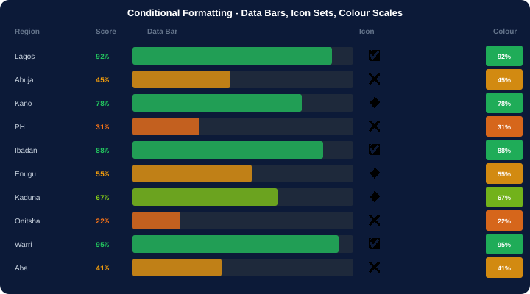
12. CONDITIONAL FORMATTING - Make Data Tell Its Own Story
Rule Type
What It Does and When to Use
Highlight Cell Rules
Colour cells based on value: Greater Than, Less Than, Between, Equal To, Duplicate Values, Top/Bottom 10. Use for KPI dashboards.
Data Bars
Adds a coloured bar inside each cell proportional to the value. Readers can compare values visually without reading numbers.
Colour Scales
Gradients from one colour to another based on value. Red-Yellow-Green is most intuitive: red=bad, green=good.
Icon Sets
Adds small icons (arrows, traffic lights, stars) inside cells. Excellent for status columns: up/down/neutral trend arrows.
Top/Bottom Rules
Automatically highlights the Top 10, Bottom 10, Above Average, or Below Average values. Dynamic - updates as data changes.
Custom Formula Rule
Select range -&gt; New Rule -&gt; Use formula -&gt; Enter =B2&lt;50000. Format applies where formula returns TRUE. Most powerful option.
condformat.xlsx
Manage Rules
Home -&gt; Conditional Formatting -&gt; Manage Rules. View, edit, delete, and reorder rules. Rules apply in order - check priority.
-- Custom Formula Examples --
Highlight entire row where Status=Done:
Select A2:F100 -&gt; New Rule -&gt; Formula:
=$F2="Done" &lt;- $ on F only, not 2
Highlight cells below target:
=B2&lt;$B$1 &lt;- B1 is the target (absolute)
Home tab -&gt; Conditional Formatting -&gt; Choose rule type -&gt; Set format -&gt; OK
Notes:
Conditional formatting. The custom formula with an absolute column reference ($F2) is the most powerful technique. By fixing the column but not the row, the formula checks column F for each row. This highlights entire rows based on one column's value - the most requested technique in professional Excel training.

Slide 19
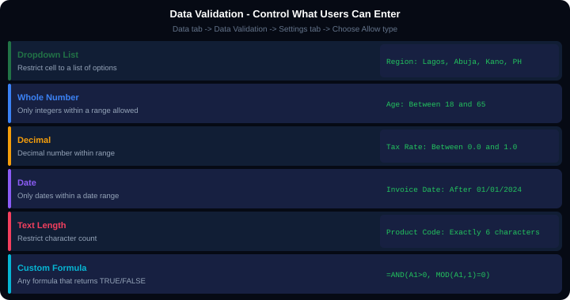
13. DATA VALIDATION - Control Input, Prevent Errors
Tab
What to Configure
Settings
Choose the Allow type (List, Whole Number, Decimal, Date, Text Length, Custom). Set the criteria and values.
Input Message
Message shown when user clicks the cell. Title + message text. Use as instructions: 'Select a region from the list'.
Error Alert
Shown when user enters invalid data. Style: Stop=prevents entry, Warning=allows but warns, Information=shows info only.
Dropdown from range
Set Source to a range: =$H$2:$H$10. Put your valid values in that range. Easier to update than a comma-separated list.
Circle Invalid Data
Data tab -&gt; Data Validation -&gt; Circle Invalid Data. Draws red circles around cells that violate the validation rule.
Custom formula
Allow: Custom -&gt; Formula: =AND(A1&gt;0,MOD(A1,1)=0) ensures positive whole numbers. =LEN(A1)=6 ensures exactly 6 characters.
validation2.xlsx
-- Dependent Dropdown Lists --
List 1 (Country): Nigeria, Ghana, Kenya
List 2 (City): INDIRECT(A2)
Named ranges: Nigeria=Lagos,Abuja,Kano
Ghana=Accra,Kumasi
INDIRECT reads A2 value as range name!
Data tab -&gt; Data Validation -&gt; Settings tab -&gt; Allow: List -&gt; Source: Lagos,Abuja,Kano,Port Harcourt
For dynamic list: Source: =$H$2:$H$10 (a range). Changes to the range auto-update the dropdown.
Notes:
Data validation. The most impactful use: dropdown lists on data entry forms ensure consistent categories. Without this, one person types 'Lagos', another types 'LAGOS', another types 'lagos ' (with trailing space). Three values, three different groups in a SUMIF. Data validation prevents this entirely. The INDIRECT dependent dropdown technique creates a city list that changes based on the country selected.

Slide 20
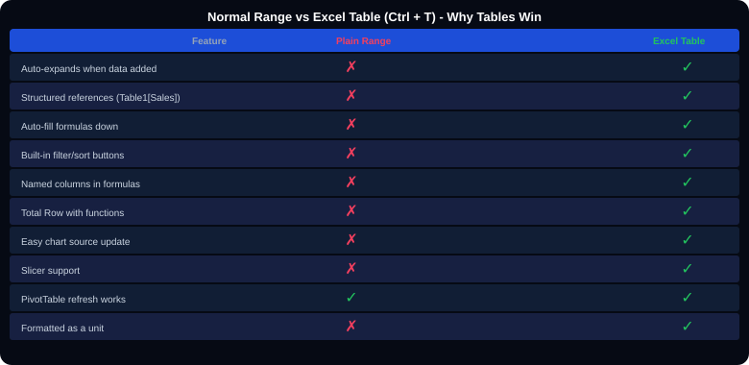
14. EXCEL TABLES - Structured Data Management
Feature
How to Use and Why It Matters
Ctrl+T
Creates an Excel Table. Gives it a blue/white striped style and activates all Table features.
Auto-expansion
New row added below table OR new column to the right automatically joins the table. Formulas extend automatically.
Structured references
=SUM(Sales[Revenue]) is more readable than =SUM(C2:C5000). Automatically adjusts when rows added. Use in formulas and PivotTables.
Total Row
Table Design -&gt; Total Row checkbox. Adds a Total row with dropdown to choose Sum/Average/Count/Max etc. per column.
Table Name
Table Design tab -&gt; Table Name box (top left). Name it something meaningful: SalesData, ProductList. Used in VLOOKUP and Power Query.
Remove Duplicates
With table selected: Table Design -&gt; Remove Duplicates. Checks selected columns and removes exact duplicate rows.
tables.xlsx
Convert back to range
Table Design -&gt; Convert to Range. Removes table functionality but keeps formatting. Do this before handing to Power BI.
-- Structured References Examples --
=SUM(SalesData[Amount])
=SUMIF(SalesData[Region],"Lagos",SalesData[Sales])
=COUNTA(SalesData[Product])
=COUNTIF(SalesData[Region],"Lagos")
[@Region] &lt;- current row reference in table
Create: Click data -&gt; Ctrl+T -&gt; Confirm range -&gt; OK. Name the table: Table Design tab -&gt; Table Name box
Structured ref: =SUM(Sales[Revenue]) instead of =SUM(C2:C1000) - reads as text, auto-adjusts range
Notes:
Excel Tables. Every professional Excel analyst converts data to a Table immediately on loading. The biggest advantage: when you add rows, every formula, chart, and PivotTable that references the table automatically includes the new data. Without a Table, you must manually expand every reference every time data grows.

Slide 21
15. NAMED RANGES - Give Cells Meaningful Names
named_ranges.xlsx
Naming Rules
What Is and Is Not Allowed
-- Create a Named Range --
Method 1: Select cells -&gt; Name Box -&gt; Type name -&gt; Enter
Method 2: Formulas -&gt; Define Name -&gt; Set name + range
Method 3: Formulas -&gt; Create from Selection -&gt; use headers
-- Examples --
Name: TaxRate Range: =Config!$D$1
Name: Regions Range: =Lists!$A$2:$A$7
Name: SalesData Range: =Sheet1!$A$1:$G$500
-- Use in Formulas --
=B2*TaxRate instead of =B2*Config!$D$1
=SUMIF(Regions,"Lagos",Sales) &lt;- readable!
=VLOOKUP(A1, ProductTable, 2, 0)
-- Manage Named Ranges --
Formulas -&gt; Name Manager (Ctrl+F3)
View, edit, delete, or update scope of names
Allowed characters
Letters, numbers, underscores, backslashes. Example: Tax_Rate_2024, ProductList, NGN_Exchange
Not allowed
Spaces (use underscore instead), hyphens, special characters, names that look like cell references (A1, B100).
Scope
Names can be Workbook-wide (any sheet can use) or Sheet-specific (only that sheet). Workbook scope is usually better.
Dynamic named range
=OFFSET(Sheet1!$A$1, 0, 0, COUNTA(Sheet1!$A:$A), 1) creates a name that expands automatically as data grows.
Use in data validation
Enter a name in Data Validation -&gt; Source: =RegionList. Changing the range updates all dropdowns using that name.
Use in formulas
=SUMIF(Regions,"Lagos",Sales) is far more readable than =SUMIF(Config!$A$2:$A$7,"Lagos",Sales!$C$2:$C$500).
dynamic_name.xlsx
-- Dynamic Named Range (expands automatically) --
Formulas -&gt; Define Name -&gt; Name: DynamicSales
Refers to: =OFFSET(Sheet1!$A$1, 0, 0,
COUNTA(Sheet1!$A:$A), 5)
-&gt; Range automatically includes all rows in A
-&gt; No need to update range when data grows
Notes:
Named ranges. The biggest benefit: when a cell reference changes (data moved to a different column), you update the name definition in one place (Name Manager) and ALL formulas using that name automatically update. Without names, you would update dozens of formulas one by one.

Slide 22
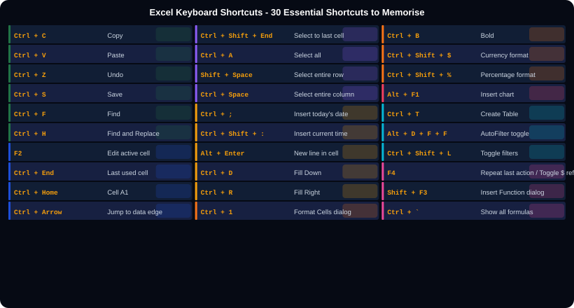
16. KEYBOARD SHORTCUTS - Work 3x Faster
Notes:
Keyboard shortcuts. The 5 most impactful shortcuts to memorise first: (1) Ctrl+Z = Undo - saves you when you make a mistake. (2) Ctrl+S = Save - do this constantly. (3) Ctrl+End = jump to last cell - navigate large sheets instantly. (4) F4 = toggle $ reference - essential for formula writing. (5) Ctrl+1 = Format Cells - faster than right-click. Master these five before the others.

Slide 23
17. DATA TOOLS - Sort, Filter, Remove Duplicates, Text to Columns
data_tools.xlsx
Tool
What It Does - When to Use
-- Sort --
Data -&gt; Sort -&gt; Sort By column -&gt; Order
Multi-level: Add Level for secondary sort
Custom Order: Sort by Mon,Tue,Wed not A-Z
-- AutoFilter --
Data -&gt; Filter (Ctrl+Shift+L toggles)
Click dropdown arrows on headers to filter
Number Filters: Top 10, Greater Than, Between
Text Filters: Contains, Begins With
Date Filters: This Month, Last Quarter, Custom
Clear all filters: Ctrl+Shift+L twice
-- Remove Duplicates --
Data -&gt; Remove Duplicates
Select which columns to check for duplicates
Tip: Check all columns for exact duplicates
Tip: Check only ID column for key duplicates
-- Text to Columns --
Fix numbers stored as text: select col -&gt;
Data -&gt; Text to Columns -&gt; Finish
Split First+Last name: delimiter = space
Split date formats: Delimited or Fixed Width
-- Flash Fill (Ctrl+E) --
Type the pattern in first row, press Ctrl+E
Excel recognises pattern and fills remaining rows
Example: A1=John Smith -&gt; B1=J.Smith -&gt; Ctrl+E
Sort (A-Z, Z-A)
Reorders rows based on one or more columns. Multi-level sort: first by Region, then by Product within each region.
AutoFilter
Adds dropdown arrows to headers. Click to filter by value, condition, or custom criteria. Only matching rows shown. Others hidden (not deleted).
Advanced Filter
Data -&gt; Advanced. Filter to a different location. Filter by complex criteria in a separate criteria range. Extract unique values.
Remove Duplicates
Permanently deletes duplicate rows. Always copy data first. Choose columns to define what 'duplicate' means - just the ID? All columns?
Text to Columns
Splits one column into multiple OR fixes numbers stored as text (run with no delimiter, just click Finish). Also converts date formats.
Flash Fill (Ctrl+E)
Pattern-matching fill. Show Excel one example (e.g. extract first name from full name) and press Ctrl+E. Excel fills the pattern for all rows.
Subtotals
Data -&gt; Subtotals. Adds automatic sum/count/average rows when the Sort column changes. Creates collapsible outline groups.
Notes:
Data tools. Flash Fill (Ctrl+E) is the most impressive tool to demonstrate live. Show: Full Name column has 'Chidi Okonkwo'. In the next column type 'Okonkwo, Chidi'. Press Ctrl+E. Excel fills the entire column with the same pattern. Students are always surprised by this. It also works for extracting domain names from email addresses, formatting phone numbers, and combining data.

Slide 24
18. POWER QUERY - Automate Data Import and Cleaning
power_query.xlsx
vs. Manual cleaning
Append = Stack rows
-- What is Power Query? --
Power Query records every cleaning step as a query.
When new data arrives, click Refresh - steps run again.
Available: Data tab -&gt; Get Data / Get and Transform
-- Common Power Query Steps --
1. Get Data -&gt; From File -&gt; From CSV/Excel
2. Remove Columns: select col -&gt; Right-click -&gt; Remove
3. Filter Rows: click dropdown on column header
4. Change Type: Transform -&gt; Data Type
5. Add Column: Transform -&gt; Custom Column
6. Group By: Transform -&gt; Group By
7. Merge Queries: Home -&gt; Merge Queries (like SQL JOIN)
8. Append Queries: Home -&gt; Append (stack tables)
9. Unpivot: Transform -&gt; Unpivot Columns
10. Close and Load -&gt; To Table
-- Key Power Query Advantages --
Connects to CSV, Excel, Web, Database, SharePoint
M language is recorded automatically (no coding)
Every step is reversible in the Applied Steps pane
Refresh updates everything with one click
-- Refresh All Data --
Data tab -&gt; Refresh All (Ctrl+Alt+F5)
Or: each query -&gt; Right-click -&gt; Refresh
Manual: open CSV, delete columns, fix formats, save. Do it again next month. Power Query: set it up once, click Refresh each month. Saves hours.
Home -&gt; Append Queries stacks multiple tables vertically. Combine Jan, Feb, Mar files into one table automatically.
Merge = SQL JOIN
Unpivot columns
Home -&gt; Merge Queries merges two tables on a common column. Choose: Left Outer, Inner, Full Outer. Same as VLOOKUP but more powerful.
Converts wide format (months as columns) to long format (one row per month). Required for PivotTables and Power BI.
pq_when.xlsx
-- When to use Power Query vs Formulas --
FORMULAS: Dynamic calculations that update
with each cell change (real-time).
POWER QUERY: Batch data import/clean from
external sources. Refresh = reprocess all.
Both can work together in the same workbook.
Notes:
Power Query. The Append Queries feature is the most popular Power Query technique for analysts: combining 12 monthly files into one annual table with one click. Set it up once: get the January file, append all other months, load to table. Next year: change the file path for January, re-run, reload all 12 months. Saves 2 hours of manual work.

Slide 25
19. WHAT-IF ANALYSIS - Scenarios, Goal Seek, Data Tables
what_if.xlsx
Tool
Business Use and Example
-- Goal Seek --
Data -&gt; What-If Analysis -&gt; Goal Seek
Set Cell: the formula cell (e.g. Profit formula)
To Value: your target (e.g. 1,000,000)
By Changing Cell: input cell (e.g. Price)
Excel reverse-engineers the required input
Example: At what price do I reach NGN 1M profit?
-- Scenario Manager --
Data -&gt; What-If Analysis -&gt; Scenario Manager
Add -&gt; Name: 'Optimistic' -&gt; Change cells -&gt; Values
Add multiple scenarios: Base, Optimistic, Pessimistic
Show -&gt; switches workbook to that scenario
Summary -&gt; creates comparison table on new sheet
-- One-Variable Data Table --
Set up formula at top of column
List input values down the left
Select range -&gt; Data -&gt; What-If -&gt; Data Table
Column input cell: the changing variable cell
Result: formula result for each input value
Goal Seek
Find the input value needed to reach a target. 'What sales volume do I need to break even?' Set Profit=0, change Units Sold.
Scenario Manager
Compare multiple sets of assumptions. 'If oil price rises by 20% vs 50% vs 100%, what happens to our margins?' Store and switch scenarios.
Data Table (1 variable)
Tests a formula for a range of input values. Shows how profit changes as price varies from NGN 50K to 500K in steps of 50K.
Data Table (2 variable)
Tests two inputs simultaneously. Creates a matrix showing profit for every combination of Price x Units. The most powerful what-if tool.
Solver
Excel add-in for optimisation. Find the combination of variables that maximises/minimises a target subject to constraints. More powerful than Goal Seek.
2var.xlsx
-- Two-Variable Data Table --
Row input (column B: Price values): 100K, 200K, 300K, 400K, 500K
Col input (row 2: Units values): 50, 100, 150, 200, 250
Formula at intersection: =B1*C1 (profit formula)
Data -&gt; Data Table -&gt; Row input cell: Price cell, Column input: Units cell
Result: Profit matrix for every Price x Units combination
Notes:
What-If Analysis. Goal Seek is the most frequently used: 'What price gives NGN 1M profit?' is a question every business analyst is asked. Scenario Manager is excellent for budget presentations: create Base/Optimistic/Pessimistic scenarios and present the Summary table to management. The Data Table is the most powerful but least taught - it creates a full sensitivity analysis matrix.

Slide 26
20. BEST PRACTICES - Professional Excel Standards
Structure your workbook
Never modify raw data
Use separate sheets: Data (raw), Calculations (formulas), Output (charts and tables), Config (rates, dates, settings). Never mix raw data with calculations.
Import raw data to a 'Data' sheet. Copy to another sheet for cleaning and analysis. Original data stays intact for reference.
Use Tables (Ctrl+T)
No merged cells in data
Convert all data ranges to Excel Tables immediately. Formulas auto-extend. PivotTables auto-refresh. Charts auto-update. Always use Tables.
Merged cells break sorting, filtering, PivotTables, and VLOOKUP. Use Center Across Selection instead: Format Cells -&gt; Alignment -&gt; Horizontal: Center Across Selection.
Hardcoded values in one place
Document your formulas
Put tax rates, exchange rates, targets, dates in a Config sheet. Reference them absolutely. Change once, updates everywhere.
Add column to the right with a plain English description of what the formula does. Use Cell Comments (Shift+F2) for complex formulas.
Protect sheets and cells
Save as .xlsx not .xls
Review -&gt; Protect Sheet to prevent accidental edits. Unlock input cells first (Ctrl+1 -&gt; Protection -&gt; uncheck Locked) before protecting the sheet.
.xls is the old 1997-2003 format. Limits of 65,536 rows and 256 columns. .xlsx supports 1,048,576 rows and 16,384 columns. Always save as .xlsx.
Notes:
Best practices. The most important rule to enforce: no merged cells in data ranges. Every time a student uses merged cells in a data table, they create problems in every downstream analysis. Center Across Selection gives the same visual result with none of the problems. Show both side by side to prove they look identical.

Slide 27
EXCEL QUICK REFERENCE CHEAT SHEET
Essential Shortcuts
Navigation
Selection
SUM / COUNT
Ctrl+S=Save Ctrl+Z=Undo Ctrl+F=Find
F2=Edit cell F4=Toggle $ Ctrl+1=Format
Ctrl+End=Last cell Ctrl+Home=A1
Ctrl+Arrow=Data edge Ctrl+G=Go To
Ctrl+A=Select all Ctrl+Space=Column
Shift+Space=Row Ctrl+Shift+End=To last
=SUM(B2:B100) =AVERAGE(B:B)
=COUNT(B:B) =COUNTA(A:A) =MAX(B:B)
Conditional Sum
IF Logic
VLOOKUP
XLOOKUP
=SUMIF(A:A,"X",B:B)
=SUMIFS(C:C,A:A,"X",B:B,"&gt;0")
=IF(A1&gt;100,"High","Low")
=IFS(A1&gt;90,"A",A1&gt;70,"B",TRUE,"C")
=VLOOKUP(A1,Table,3,0)
=IFERROR(VLOOKUP(A1,T,2,0),"?")
=XLOOKUP(A1,B:B,C:C,"Not found")
(Excel 365/2021 only)
INDEX MATCH
Text Functions
Date Functions
Error Handling
=INDEX(C:C,MATCH(A1,B:B,0))
Can look in any direction
=TRIM(A1) =PROPER(A1) =LEN(A1)
=LEFT(A1,5) =MID(A1,3,4) =CONCAT(A1,B1)
=TODAY() =YEAR(A1) =MONTH(A1)
=DATEDIF(A1,B1,"Y") =EDATE(A1,3)
=IFERROR(formula, 0)
=IFNA(VLOOKUP(...),"Missing")
Conditional Formatting
PivotTable
Excel Table
Power Query
Home -&gt; Conditional Formatting
Data Bars, Colour Scales, Icon Sets, Custom
Insert -&gt; PivotTable
Drag: Rows / Columns / Values / Filters
Ctrl+T = Create Table
Structured ref: =SUM(Table1[Sales])
Data -&gt; Get Data -&gt; From File
Refresh All = Ctrl+Alt+F5
Notes:
Cheat sheet. Print and give to every student. The most valuable reference card covers all 16 topic areas. Green = Excel core functions. Blue = navigation and lookup. Amber = logic and formatting. Teal = text, dates, Power Query.

Slide 28
📊
Microsoft Excel
Complete Teaching Deck
20 Topics Covered:
Interface
Navigation
Data Entry
Formulas
Cell References
Math Functions
IF and Logic
Lookup Functions
Text Functions
Date Functions
Charts
PivotTables
Conditional Format
Data Validation
Excel Tables
Named Ranges
Shortcuts
Data Tools
Power Query
Best Practices
Excel is the world's most widely used data analysis tool. Master it and every other tool becomes easier.
Next: Microsoft Power BI - Build Interactive Dashboards from Excel Data
Kajola Gbenga Adewale
Data Analytics Expert

